Slide 1
HEALTH MONITORING SYSTEM
LETS GET HEALTHY . . .

Slide 2


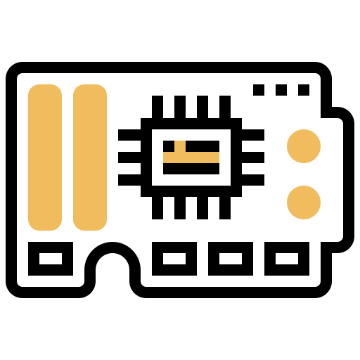

TABLE OF CONTENTS
OVERVIEW
BLOCK DIAGRAM
COMPONENTS
TEAM MEMBERS

Slide 3

ABSTRACT OVERVIEW

Slide 4

ABSTRACT OVERVIEW
As per the increasing covid cases across the world.
The monitoring of the covid patient also increasing day by day
Here comes an abundant need for the monitoring humans also increases.
So here comes the solution of using IOT based real time health monitoring system
Which monitors the patient and uploads the data to the respective doctor and also helping in preventing covid spreading furthur

Slide 5
BLOCK DIAGRAM
1
2
3
4
5
6

Slide 6
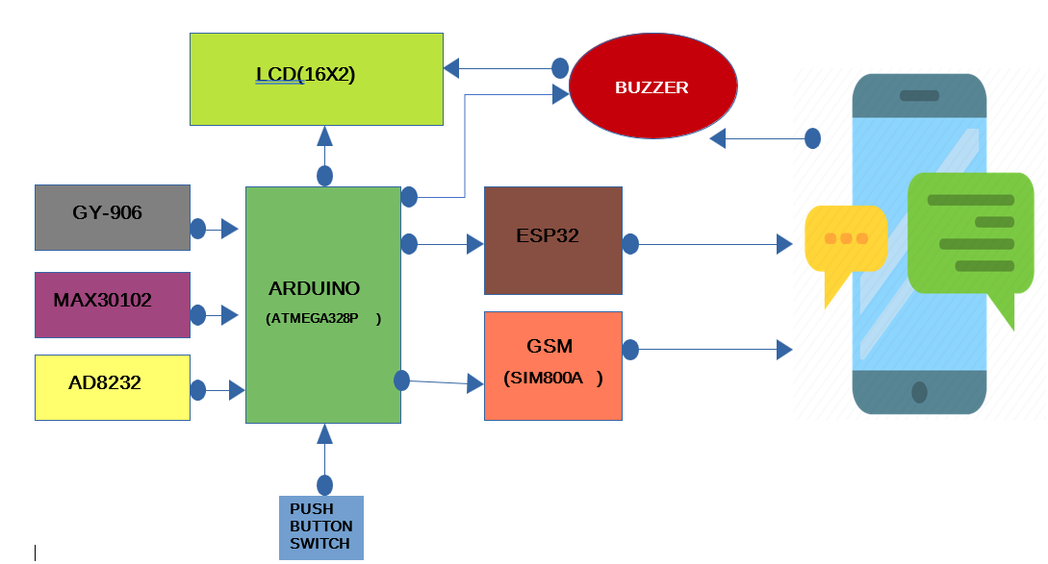
BLOCK DIAGRAM

Slide 7

KEY POINTS IN BLOCK DIAGRAM
ARDUINO UNO
ESP32
GSM MODULE
MAX30102
ADA8232
GY-906
LCD
BUZZER
PUSH BUTTON

Slide 8

MONITORING PROCESS
TEPERATURE by GY-906
HEART BEAT by MAX30102
ECG READINGS by ADA8232
SP02 READINGS by MAX30102
This Photo by Unknown Author is licensed under CC BY-SA-NC

Slide 9
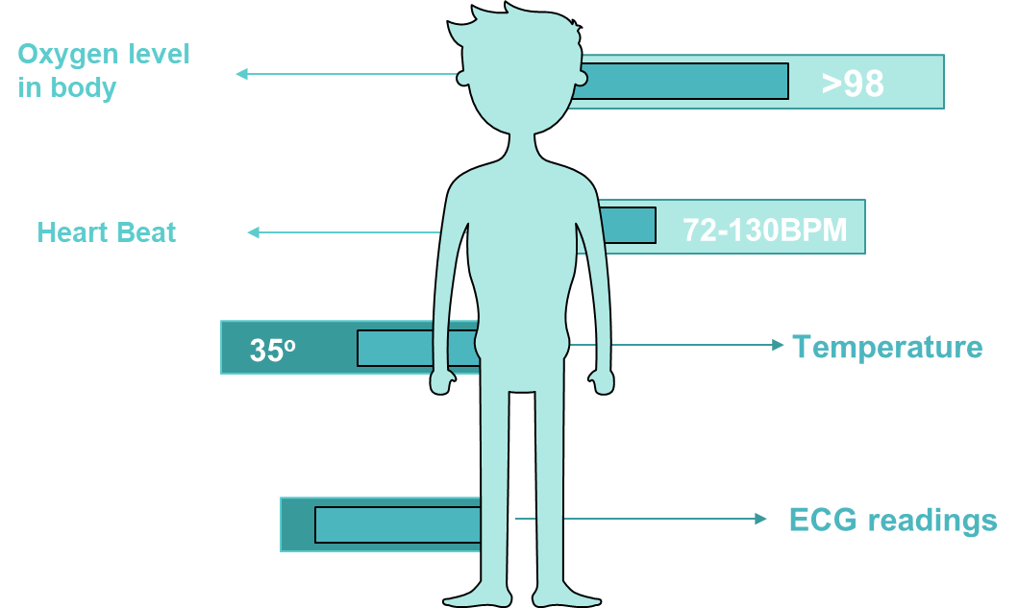
BASIC CARE FOR A COVID PATIENT

Slide 10
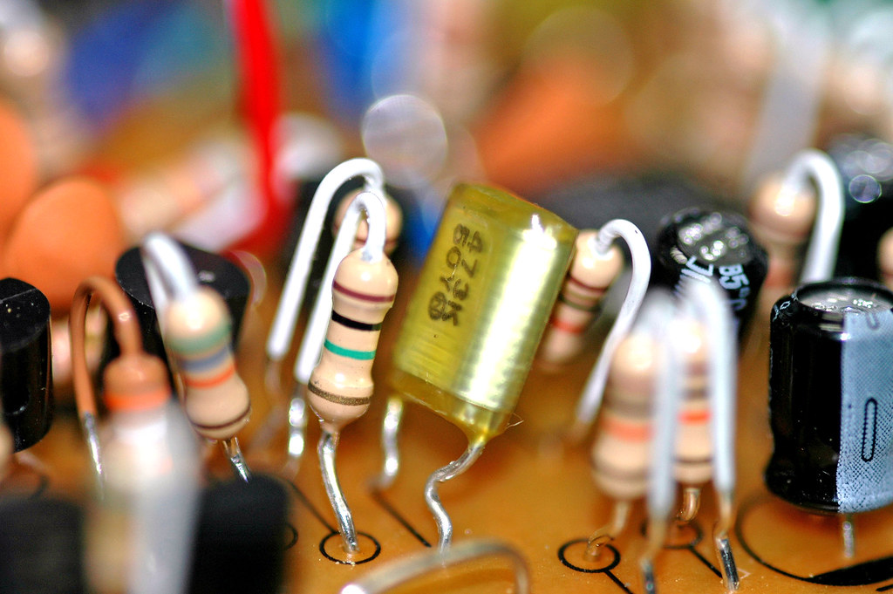
COMPONENTS IN THE PROJECT
There are number of components used In the project.
There are basically two types of components they are
Hardware components
Software components

Slide 11
HARDWARE COMPONENTS CLASSIFICATION
ARDUINO UNO
ESP32
DEVELOPMENT BOARDS
GSM MODULE
LCD16X2
ADA8232
MAX30102
SENSORS
GM906
BUZZER
LED’s
Push button switch

Slide 12

DEVELOPENT BOARDS

Slide 13
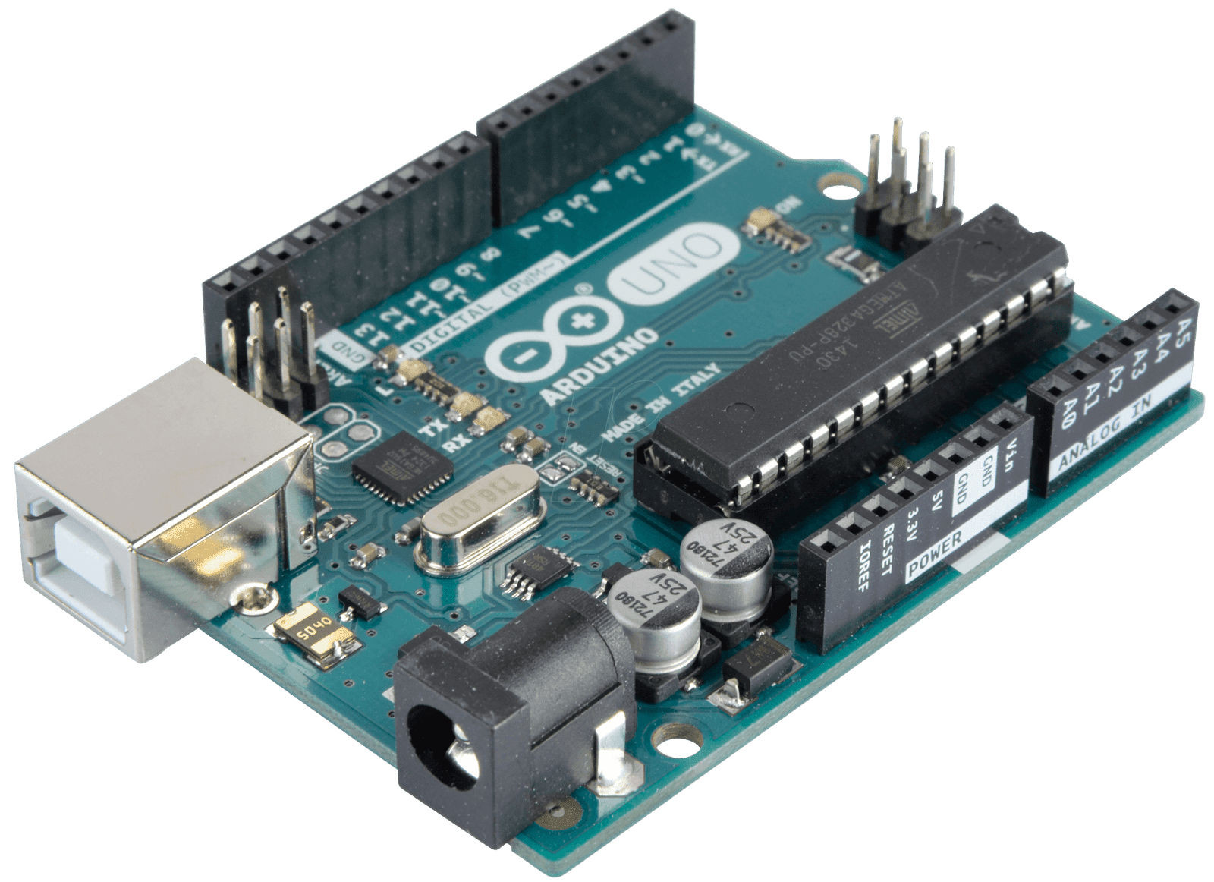
1. AURDINO UNO R3
The Arduino UNO is the best board to get started with electronics and coding. If this is your first experience tinkering with the platform, the UNO is the most robust board you can start playing with. The UNO is the most used and documented board of the whole Arduino family.
It has 14 digital input/output pins (of which 6 can be used as PWM outputs), 6 analog inputs, a 16 MHz ceramic resonator ,a USB connection, a power jack, an ICSP header and a reset button. It contains everything needed to support the microcontroller
Low Cost, flexible, easy to use programmable open source microcontroller board.
It can control relays, LED, Motors as an output.
Arduino is programmed with C++ language

Slide 14
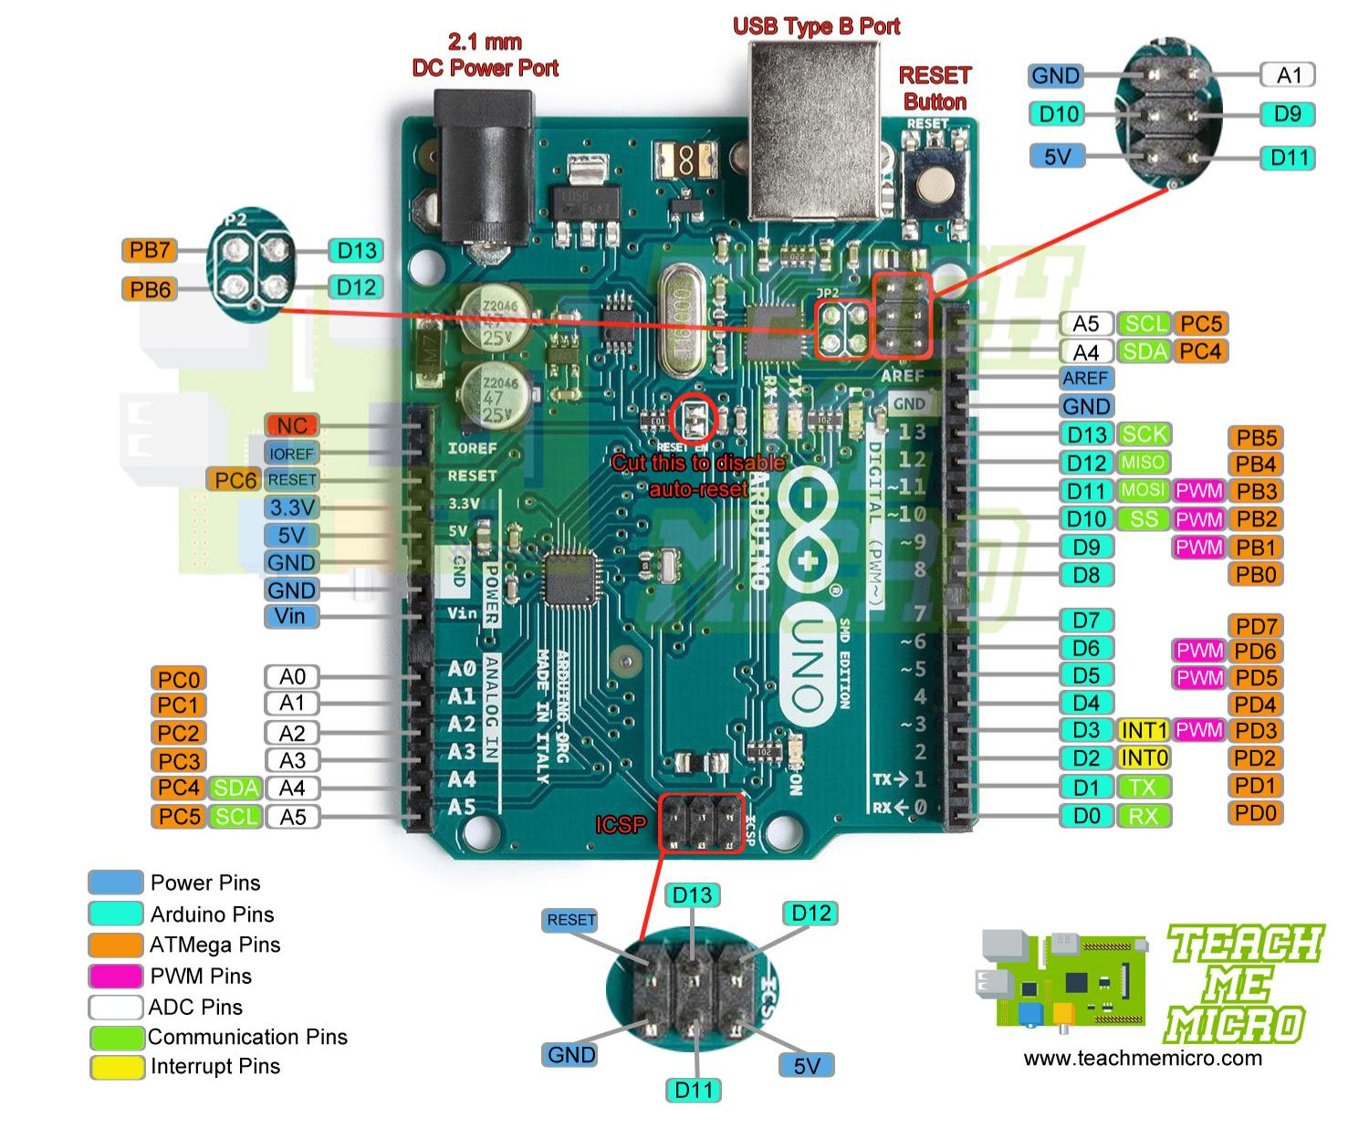
AURDINO UNO R3
There are 14 pins
6 provide PWN output
Analog i/p = 6/8
Flash memory =16KB
SRAM = 2KB
DC current i/p or o/p pins = 40mA

Slide 15
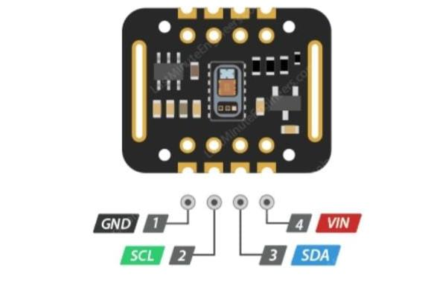
2. Max 30102 (Pulse Oximeter)
The MAX30102 is an integrated pulse oximetry and heart-rate monitor biosensor module. It includes internal LEDs, photodetectors, optical elements, and low-noise electronics with ambient light rejection. The MAX30102 provides a complete system solution to ease the design-in process for mobile and wearable devices.
Pulse oximetry is a noninvasive test that measures the oxygen saturation level of your blood. It can rapidly detect even small changes in oxygen levels. These levels show how efficiently blood is carrying oxygen to the extremities furthest from your heart, including your arms and legs.

Slide 16
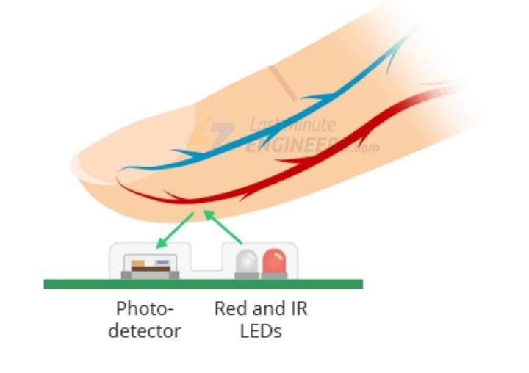
Pulse Oximeter
A blood-oxygen monitor displays the percentage of blood that is loaded with oxygen. More specifically, it measures what percentage of hemoglobin, the protein in blood that carries oxygen, is loaded. Acceptable normal SaO2 ranges for patients without pulmonary pathology are from 95 to 99 percent.[citation needed] For a person breathing room air at or near sea level, an estimate of arterial pO2 can be made from the blood-oxygen monitor "saturation of peripheral oxygen“.
The pulse oximeter uses a cold light source that shines a light through the fingertip, making the tip appear to be red. By analyzing the light from the light source that passes through the finger, the device is able to determine the percentage of oxygen in the red blood cell

Slide 17
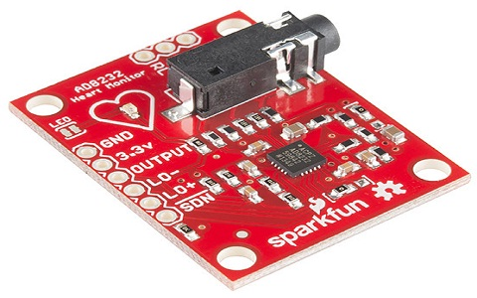
3. ECG Sensor (AD8232)
The electrocardiography or ECG is a technique for gathering electrical signals which are generated from the human heart. When someone experiences physiological arousal then the ECG sensor allows us to recognize the level, however, it is also used for understanding the psychological state of humans. So an AD8232 sensor is used to calculate the electrical activity of the heart. This is a small chip and the electrical action of this can be charted like an ECG (Electrocardiogram). Electrocardiography can be used to help in diagnosing different conditions of the heart. This article provides an overview of the AD8232 ECG Sensor.
The AD8232 ECG sensor is a commercial board used to calculate the electrical movement of the human heart. This action can be chart like an Electrocardiogram and the output of this is an analog reading. Electrocardiograms can be very noisy, so to reduce the noise the AD8232 chip can be used. The working principle of the ECG sensor is like an operational amplifier to help in getting a clear signal from the intervals simply.

Slide 18
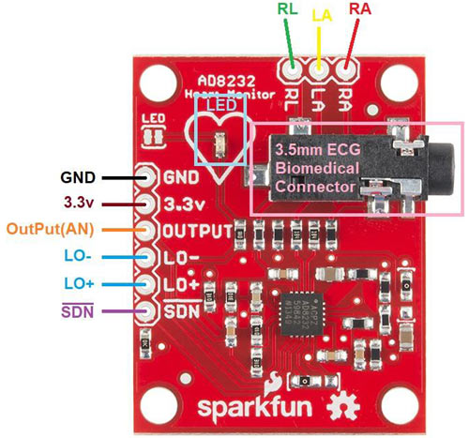
ECG Sensor (AD8232)
AD8232 Pin Configuration
The heart rate monitoring sensor like AD8232 includes the pins like SDN pin, LO+ pin, LO- pin, OUTPUT pin, 3.3V pin, and GND pin. So that we can connect this IC to development boards like Arduino by soldering pins.
Additionally, this board includes pins like the right arm (RA), left arm (LA) & right leg (RL) pins to connect custom sensors. An LED indicator in this board is used to indicate the heartbeat rhythm of humans.
The AD8232 sensor comprises a function like quick restore, used to decrease the length of long resolving tails of the HPFs. This sensor is accessible in a 4 mm × 4 mm size, and the package of this sensor is 20-lead LFCSP. It operates from −40°C -to- +85°C but the performance is specified from 0°C -to- 70°C.

Slide 19
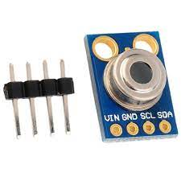
4. GY906 (Temperature Sensor)
GY-906 MLX90614ESF -BCC Contactless Temperature Sensor Module is an infrared thermometer for use with Arduino or any microcontroller that can communicate with it through its I2C interface. This is an infrared thermometer designed for non-contact temperature sensing.
MLX90614 is an infrared thermometer for non-contact temperature measurements.
Both the IR sensitive thermopile detector chip and the signal conditioning ASIC are integrated in the same TO-39 can.
Integrated into the MLX90614 are a low noise amplifier, 17-bit ADC and powerful DSP unit thus achieving high accuracy and resolution of the thermometer.

Slide 20
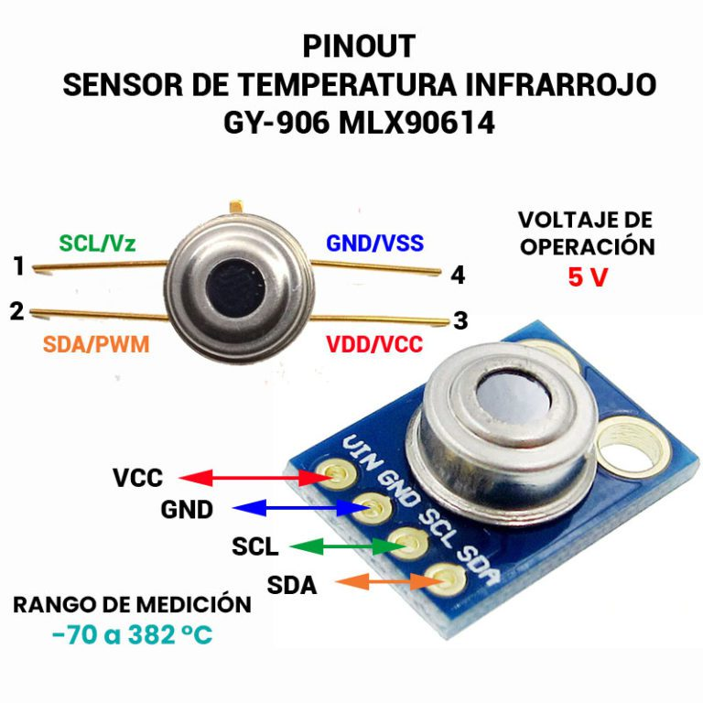
GY906 (Temperature Sensor)
The thermometer comes factory calibrated with a digital SMBus output giving full access to the measured temperature in the complete temperature range(s) with a resolution of 0.02°C.
The user can configure the digital output to be pulse width modulation (PWM). As a standard, the 10-bit PWM is configured to continuously transmit the measured temperature in range of -20 to 120°C, with an output resolution of 0.14°C.

Slide 21
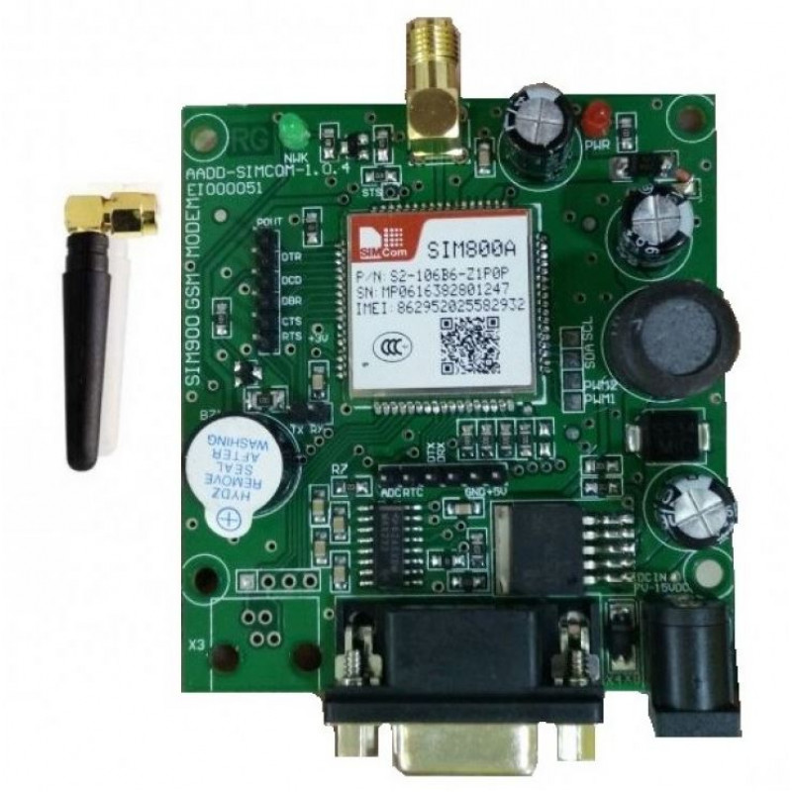
5. SLM800A (GSM Module)
The SIM800A Quad-Band GSM/GPRS Module with RS232 Interface is a complete Quad-band GSM/GPRS solution in an LGA(Land grid array) type which can be embedded in the customer applications. SIM800A support Quad-band 850/900/1800/1900 MHz, it can transmit Voice, SMS and data information with low power consumption.
A GSM modem is a wireless modem that works with a GSM wireless network. A wireless modem behaves like a dial-up modem. The main difference between them is that a dial-up modem sends and receives data through a fixed telephone line while a wireless modem sends and receives data through radio waves.

Slide 22
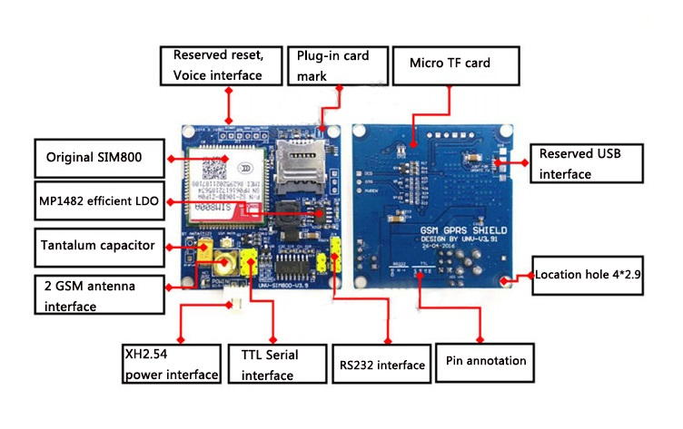
GSM Module (SIM 800A) Pin Diagram

Slide 23
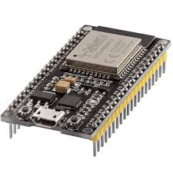
6. ESP 32
ESP32 is a series of low-cost, low-power system on a chip microcontrollers with integrated Wi-Fi and dual-mode Bluetooth. The ESP32 series employs either a Tensilica Xtensa LX6 microprocessor in both dual-core and single-core variations, Xtensa LX7 dual-core microprocessor or a single-core RISC-V microprocessor and includes built-in antenna switches, RF balun, power amplifier, low-noise receive amplifier, filters, and power-management modules. ESP32 is created and developed by Espressif Systems, a Shanghai-based Chinese company, and is manufactured by TSMC using their 40 nm process.^{[2]} It is a successor to the ESP8266 microcontroller.

Slide 24
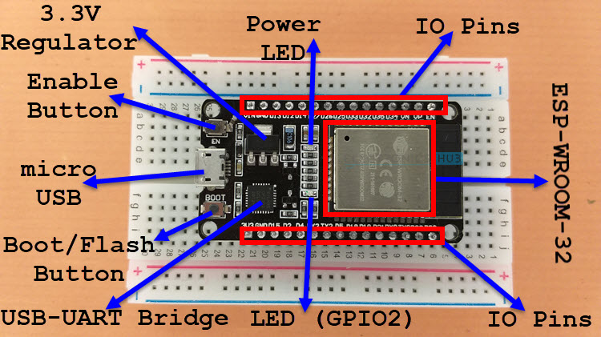
ESP 32 Pin Diagram

Slide 25
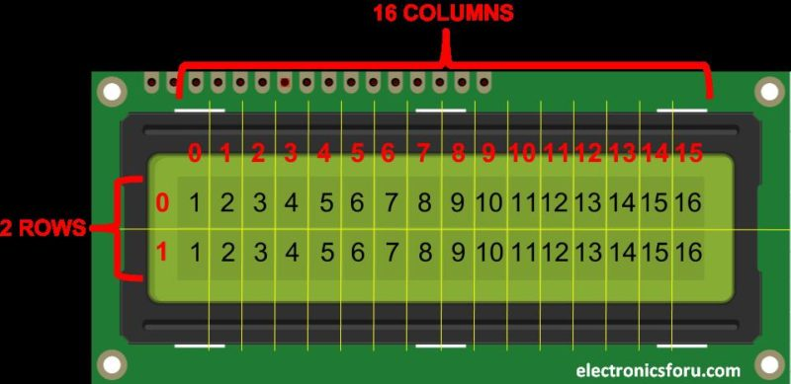
7. LCD 16x2
An LCD screen is an electronic display module that uses liquid crystal to produce a visible image. The 16×2 LCD display is a very basic module commonly used in DIYs and circuits. The 16×2 translates o a display 16 characters per line in 2 such lines. In this LCD each character is displayed in a 5×7 pixel matrix.
Generating custom characters on LCD is not very hard. It requires the knowledge about custom generated random access memory (CG-RAM) of LCD and the LCD chip controller. Most LCDs contain Hitachi HD4478 controller.
CG-RAM is the main component in making custom characters. It stores the custom characters once declared in the code. CG-RAM size is 64 byte providing the option of creating eight characters at a time. Each character is eight byte in size.

Slide 26
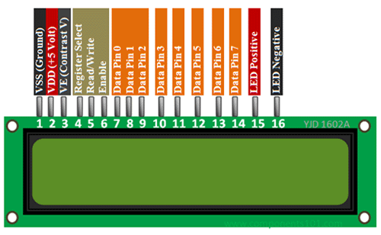
LCD 16x2 Pin Diagram

Slide 27
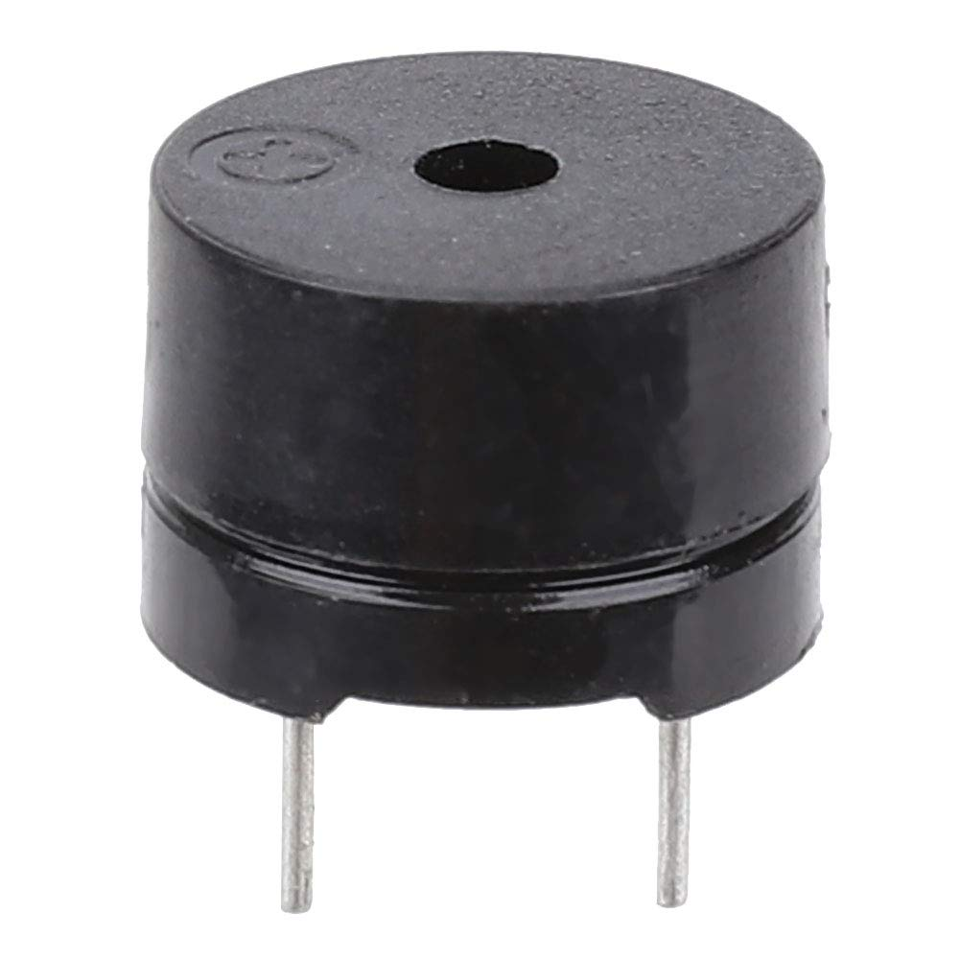
8. Buzzer
A buzzer or beeper is an audio signaling device, which may be mechanical, electromechanical, Typical uses of buzzers and beepers include alarm devices, timers, and confirmation of user input such as a mouse click or keystroke.
Buzzer. A buzzer converts electricity into sound when current flows through it. It is drawn as half a circle with two short lines extending down.

Slide 28
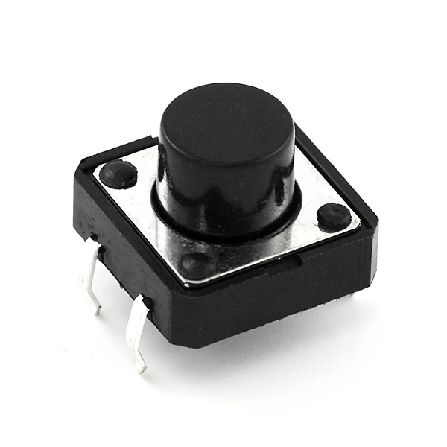
9. Push Button
A push-button (also spelled pushbutton) or simply button is a simple switch mechanism to control some aspect of a machine or a process. Buttons are typically made out of hard material, usually plastic or metal.^{[1]} The surface is usually flat or shaped to accommodate the human finger or hand, so as to be easily depressed or pushed. Buttons are most often biased switches, although many un-biased buttons (due to their physical nature) still require a spring to return to their un-pushed state. Terms for the "pushing" of a button include pressing, depressing, mashing, slapping, hitting, and punching.

Slide 29
SOFTWARE COMPONENTS
The software requirerments of the project

Slide 30
The two IDE’S for arduino programmig
Arduino IDE
PROGRAMMER
It’s a arduino based open source platform IDE from arduino official site
It’s a third party software fot arduino programming .

Slide 31
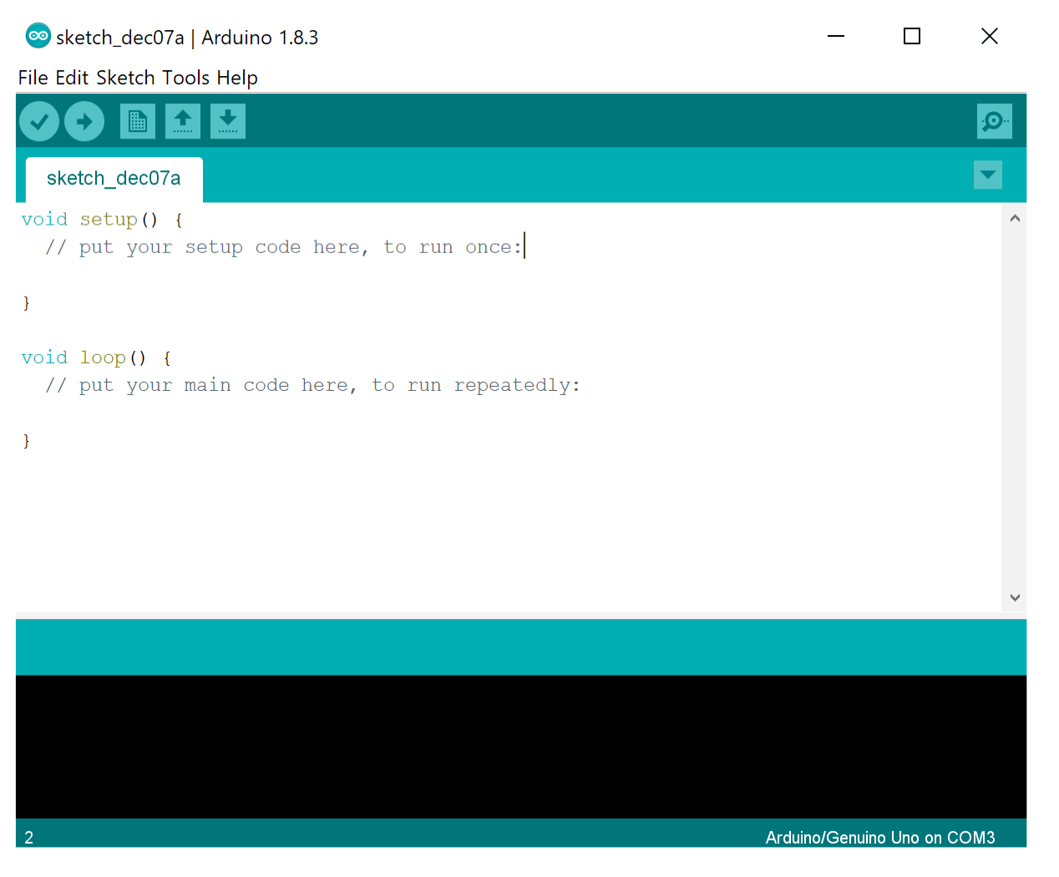
BASICALLY WE USE ARDUINO IDE from the official site
The open-source Arduino Software (IDE) makes it easy to write code and upload it to the board. This software can be used with any Arduino board.

Slide 32
OUR TEAM
19253-EC-243©
19253-EC-224
19253-EC-228
19253-EC-238
19253-EC-253

